Slide 1


POWER
欧美风商务计划书
The user can demonstrate on a projector or computer, or print the presentation and make it into a film to be used in a wider field
汇报人： XXXX 汇报时间：XX年XX月

Slide 2
目录CONTENTS
1
2
3
4
标题添加此处
标题添加此处
标题添加此处
标题添加此处

Slide 3

1
标题添加此处
The user can demonstrate on a projector or computer, or print the presentation and make it into

Slide 4

POWER POINT
标题添加此处
The user can demonstrate on a projector or computer, or print the presentation and make it intoThe user can demonstrate on a projector or computer, or print the presentation and make it intoThe user can demonstrate on a projector or computer, or print the presentation and make it intoThe user can demonstrate on a projector or computer, or print the presentation and make it into

Slide 5
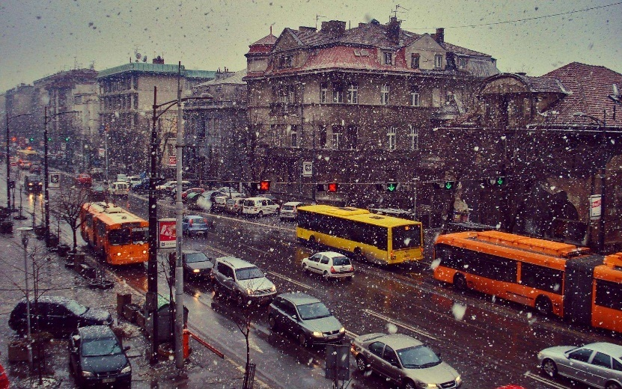


POWER POINT
标题添加此处
标题添加此处
标题添加此处
The user can demonstrate on a projector or computer, or print the presentation and make it into
The user can demonstrate on a projector or computer, or print the presentation and make it into
The user can demonstrate on a projector or computer, or print the presentation and make it into

Slide 6









POWER POINT
标题添加此处
The user can demonstrate on a projector or computer, or print the presentation and make it intoThe user can demonstrate on a projector or computer, or print the presentation and make it intoThe user can demonstrate on a projector or computer, or print the presentation and make it intoThe user can demonstrate on a projector or computer, or print the presentation and make it intoThe user can demonstrate on a projector or computer, or print the presentation and make it intoThe user can demonstrate on a projector or computer, or print the presentation and make it into

Slide 7
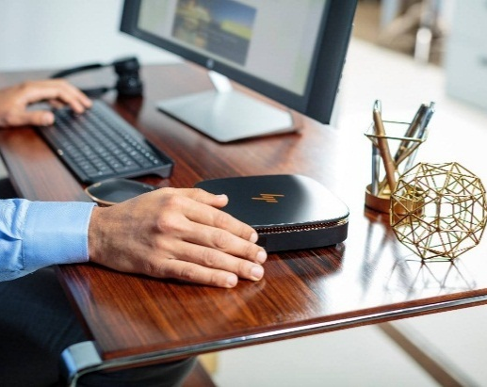

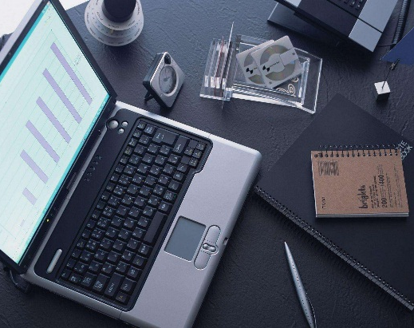
POWER POINT
The user can demonstrate on a projector or computer, or print the presentation and make it intoThe user can demonstrate on a projector or computer, or print the presentation and make it intoThe user can demonstrate on a projector or computer, or print the presentation and make it intoThe user can demonstrate on a projector or computer, or print the presentation and make it intoThe user can demonstrate on a projector or computer, or print the presentation and make it intoThe user can demonstrate
标题添加此处
标题添加此处
标题添加此处
标题添加此处
标题添加此处
标题添加此处
标题添加此处
标题添加此处
标题添加此处

Slide 8

POWER POINT
标题添加此处
The user can demonstrate on a projector or computer, or print the presentation and make it intoThe user can demonstrate on a projector or computer, or print the presentation and make it intoThe user can demonstrate on a projector or computer, or print the presentation and make it into

Slide 9
2
标题添加此处
The user can demonstrate on a projector or computer, or print the presentation and make it into

Slide 10



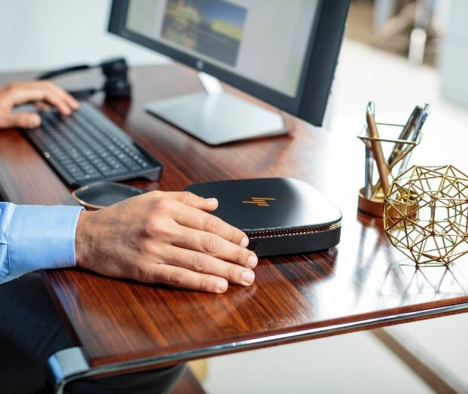
POWER POINT
标题添加此处
标题添加此处
标题添加此处
标题添加此处
The user can demonstrate on a projector or computer, or print the presentation and make it into
The user can demonstrate on a projector or computer, or print the presentation and make it into
The user can demonstrate on a projector or computer, or print the presentation and make it into
The user can demonstrate on a projector or computer, or print the presentation and make it into

Slide 11




POWER POINT
标题
添加
标题
添加
标题
添加
标题
添加
The user can demonstrate on a projector or computer, or print the presentation and make it into
The user can demonstrate on a projector or computer, or print the presentation and make it into
The user can demonstrate on a projector or computer, or print the presentation and make it into
The user can demonstrate on a projector or computer, or print the presentation and make it into

Slide 12

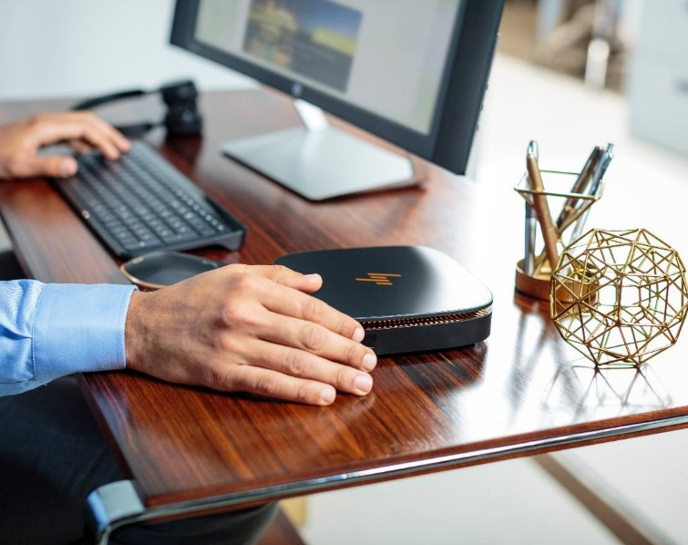



Slide 13

POWER POINT
标题添加此处
The user can demonstrate on a projector or computer, or print the presentation and make it intoThe user can demonstrate on a projector or computer, or print the presentation and make it intoThe user can demonstrate on a projector or computer, or print the presentation and make it intoThe user can demonstrate on a projector or computer, or print the presentation and make it intoThe user can demonstrate on a projector or computer, or print the presentation and make it intoThe user can demonstrate on a projector or computer, or print the presentation and make it into

Slide 14
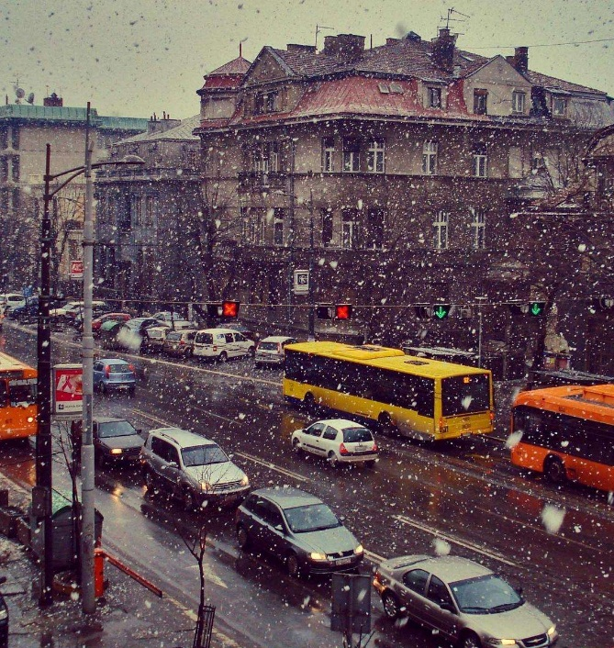


POWER POINT
标题添加此处
The user can demonstrate on a projector or computer, or print the presentation and make it intoThe user can demonstrate on a projector or computer, or print the presentation and make it intoThe user can demonstrate on a projector or computer, or print the presentation and make it intoThe user can demonstrate on a projector or computer, or print the presentation and make it intoThe user can demonstrate on a projector or computer, or print the presentation and make it intoThe user can demonstrate on a projector or computer, or print the presentation and make it into

Slide 15
3
标题添加此处
The user can demonstrate on a projector or computer, or print the presentation and make it into

Slide 16
POWER POINT
此部分内容作为文字排版占位显示
标题添加此处
标题添加此处
The user can demonstrate on a projector or computer, or print the presentation and make it into
标题文本预设
The user can demonstrate on a projector or computer, or print the presentation and make it into

Slide 17
POWER POINT
The user can demonstrate on a projector or computer, or print the presentation and make it into
标题
添加此处
The user can demonstrate on a projector or computer, or print the presentation and make it into
The user can demonstrate on a projector or computer, or print the presentation and make it into

Slide 18









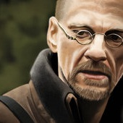

Slide 19
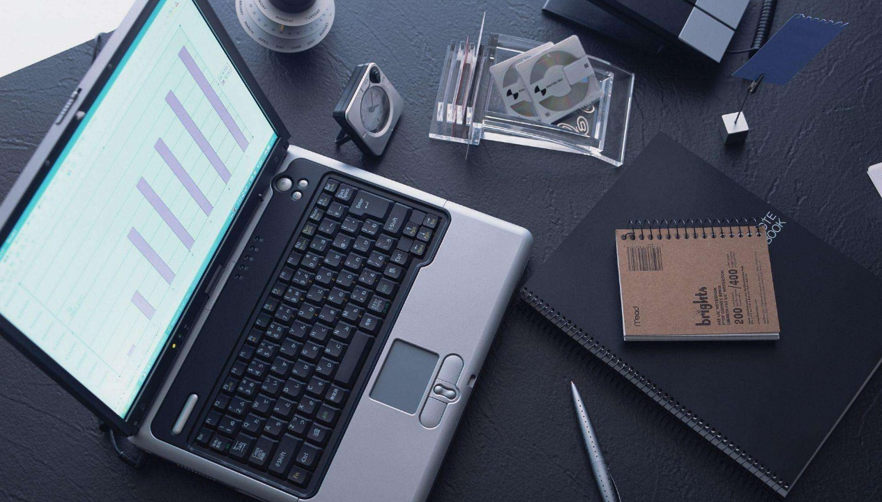
POWER POINT
标题添加此处
The user can demonstrate on a projector or computer, or print the presentation and make it intoThe user can demonstrate on a projector or computer, or print the presentation and make it intoThe user can demonstrate on a projector or computer, or print the presentation and make it intoThe user can demonstrate on a projector or computer, or print the presentation and make it intoThe user can demonstrate on a projector or computer, or print the presentation and make it intoThe user can demonstrate on a projector or computer, or print the presentation and make it into

Slide 20
4
标题添加此处
The user can demonstrate on a projector or computer, or print the presentation and make it into

Slide 21
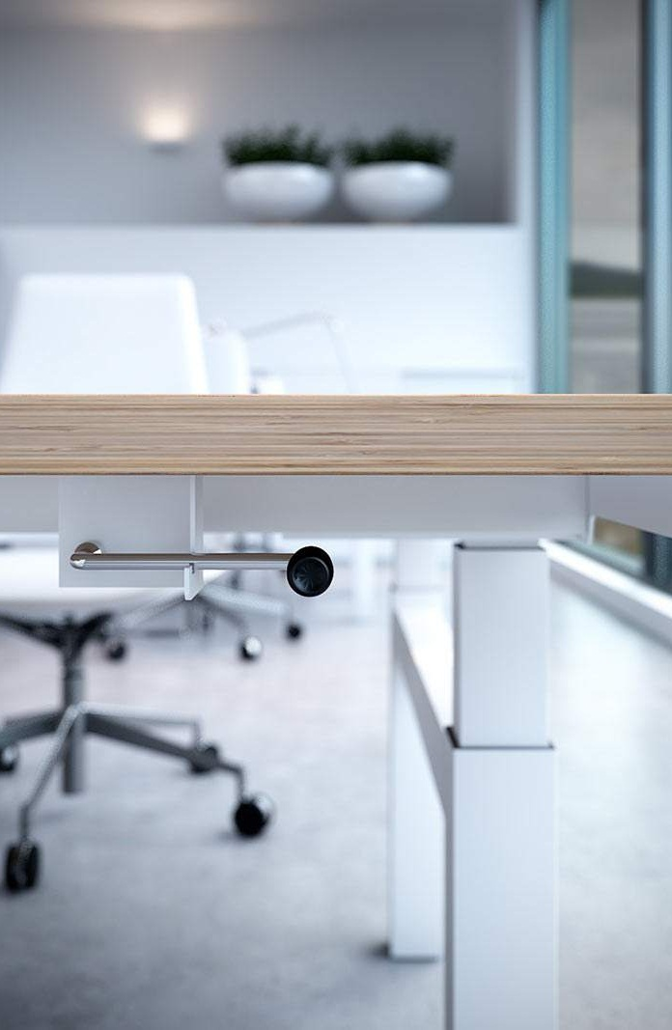
POWER POINT
标题添加此处
The user can demonstrate on a projector or computer, or print the presentation and make it into
标题添加此处
The user can demonstrate on a projector or computer, or print the presentation and make it into
标题添加此处
The user can demonstrate on a projector or computer, or print the presentation and make it into
标题添加此处
The user can demonstrate on a projector or computer, or print the presentation and make it into

Slide 22

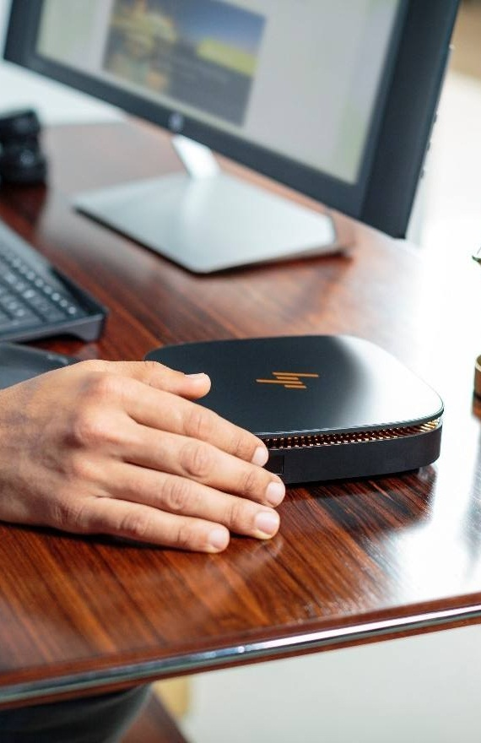
标题添加此处
The user can demonstrate on a projector or computer, or print the presentation and make it into
标题添加此处
The user can demonstrate on a projector or computer, or print the presentation and make it into
标题添加此处
The user can demonstrate on a projector or computer, or print the presentation and make it into

Slide 23
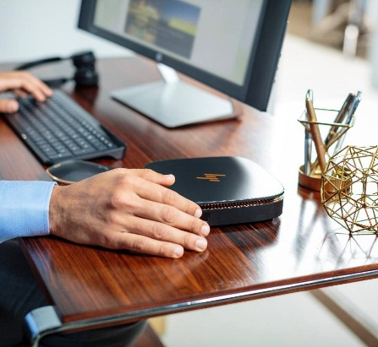



POWER POINT
标题添加此处
标题添加此处
The user can demonstrate on a projector or computer, or print the presentation and make it into
The user can demonstrate on a projector or computer, or print the presentation and make it into
标题添加此处
标题添加此处
The user can demonstrate on a projector or computer, or print the presentation and make it into
The user can demonstrate on a projector or computer, or print the presentation and make it into

Slide 24

标题添加此处
The user can demonstrate on a projector or computer, or print the presentation and make it intoThe user can demonstrate on a projector or computer, or print the presentation and make it intoThe user can demonstrate on a projector or computer, or print the presentation and make it intoThe user can demonstrate on a projector or computer, or print the presentation and make it intoThe user can demonstrate on a projector or computer, or print the presentation and make it intoThe user can demonstrate on a projector or computer, or print the presentation and make it into

Slide 25
POWER
感谢您的观看
The user can demonstrate on a projector or computer, or print the presentation and make it into a film to be used in a wider field

